Slide 1
Research Platform for Custom Memory Cube
Yu Zou
Graduate Student (Research Assistant)
Dr. Herman Lam
Assoc. Professor of ECE
University of Florida

Slide 2
Outline
Introduction: Hybrid Memory Cube (HMC)
Motivation and goals for CMC research platform
HT Programming
Hybrid-threading toolset
Architecture
Data structures
Data access patterns
HT code example
Vector add
HT Demo
Bloom filter

Slide 3
Outline
Introduction: Hybrid Memory Cube (HMC)
Motivation and goals for CMC research platform
HT Programming
Hybrid-threading toolset
Architecture
Data structures
Data access patterns
HT code example
Vector add
HT Demo
Bloom filter

Slide 4
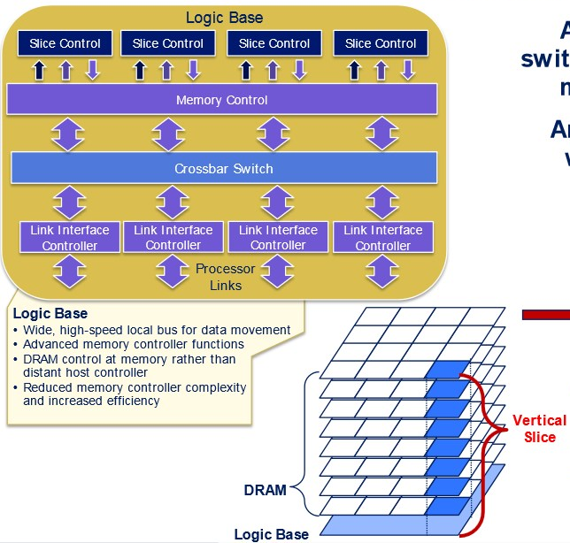


Introduction
Hybrid memory cube
High-performance RAM interface for through-silicon vias (TSV)-based stacked DRAM memory
Logic base (layer)
High bandwidth
~10% energy per bit of current DDR memories

Slide 5
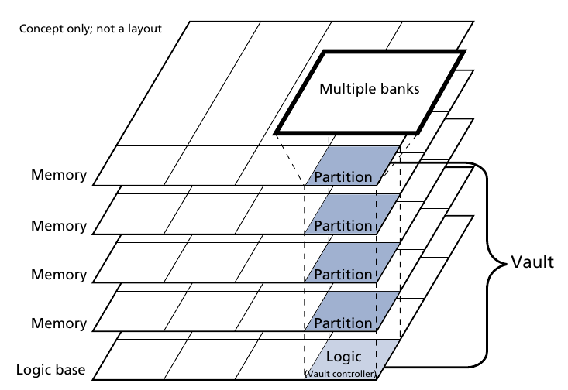
Advantage of HMC
High bandwidth comes from internal parallelism
Vaults can be accessed in parallel
Banks can be accessed in pipeline
But not enough ! ! !
Pins constrain max. bandwidth
Bottleneck for data-intensive
apps
Big data, e.g. PageRank
Gnome research, e.g. DNA
sequencing

Slide 6
Custom Memory Cube (CMC)
Motivation
Increasing need for fast high-performance parallel processing
Memory accesses of data-intensive apps consumes considerable time
Near memory processing or in-memory processing
DRAM Layers
CMC
CPU
Data Processing
Logic Layer

Slide 7
High Bandwidth of CMC
HMC configuration
16 HMCs are chained together
Size – 8 GB
64 bit vertical interface each DRAM partition
32 vaults per cube
TSV signaling rate 2 Gb/s
8 high-speed external serial links
Available external bandwidth – 320 GB/s
Available internal bandwidth – 8 TB/s
25x

Slide 8


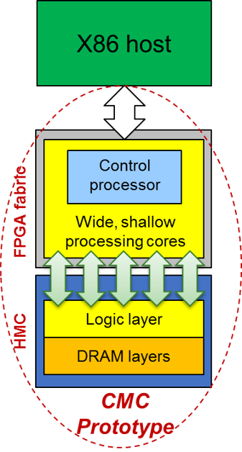
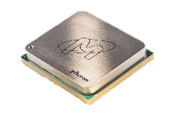


CMC Research Platform
Goal
Create research platform for design-space exploration CMC apps & arch (C-RAM* & PIM**)
Motivation
Memory-intensive apps: memory bottleneck & high energy consumption
HMC: higher B/W & lower power than current memories
Potential for C-RAM* & PIM** processing (CMC)
Approach
Create initial prototype of CMC arch using FPGA+HMC
Explore perf. measurement methods for CMC platform
Research perf. modelling for notional CMC architecture
Initial case study CMC app
*C-RAM: Computational RAM
**PIM: Processor In Memory

Slide 9
Notional CMC Architecture*
Based on Nair et al.* : an HMC with a user-programmable logic layer
A, B, C, D, and E: performance-measurement points of interest
* Nair, R., et al. "Active Memory Cube: A processing-in-memory architecture for exascale systems.“ IBM Journal of Res. & Development 59.2/3 (2015): 17-1.

Slide 10
Performance Measurement on Merlin Board
CMC platform on Merlin board
*
Instrumented Merlin infrastructure with hardware performance monitors
A’, B’, C’, D’, M1, M2, M3, M4, M5, and E’
VB*: View Buffer

Slide 11
Mapping Notional CMC onto Merlin Board
Merlin board
Case study: model of a notional CMC
Simplifying assumption:
For this model, this part of CMC is assumed to have an HMC architecture

Slide 12
Model of CMC-to-Merlin Mapping
Model of notional CMC
CMC platform on Merlin board
Latency A = ctrl signal transfer time B + latency C + result transfer time B
Ctrl signal transfer time B : time to transfer control signals between host and CMC
Data transfer time B: time for host access to obtain result (e.g., transfer from view buffer)
Latency C = delay TSV* + latency C’ – delay D’minusE’
Delay D’minusE’ = latency D’ – latency E’
* delay TSV= between DRE core and switch, time to transfer a request +
time to transfer response of that request
Latency: round-trip delay from input into a point in the system to desired outcome

Slide 13
Advantage of Platform
Fast prototyping
Short emulation time
PageRank
2^20 vertices, floating data
SystemC simulation: 10~15 minutes
Easy to change
Slow validation
Not accurate performance prediction
CMC platform emulation: less than 1 minutes
4+ hours to generate bitfile
Quick validation
Accurate performance prediction

Slide 14
Outline
Introduction: Hybrid Memory Cube (HMC)
Motivation and goals for CMC research platform
HT Programming
Hybrid-threading toolset
Programming Model
Data structures
Data access patterns
HT code example
Vector add
HT Demo
Bloom filter

Slide 15
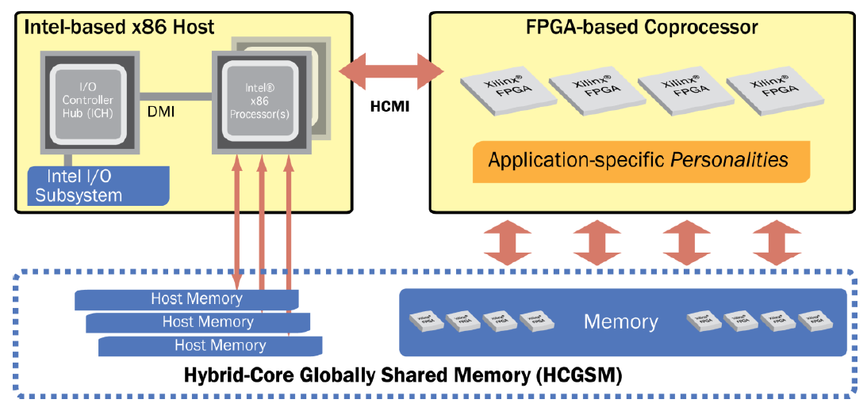
Convey HT Background
Convey computers
Startup since 2006, based @ Texas
Hybrid-core computing platforms
Joined CHREC in 2013
Via F3, focusing on bioinformatics app acceleration
Convey system philosophy – hybrid-core computing
Features | Convey
Programming | C/Cpp/ASM + HT + (HDL)
Data Addressing | explict, consistent
Host Connection | PCIe 2.0/3.0
HT : Hybrid threading - Convey’s HLS-like programming tool

Slide 16
Overview of HT Programming Model
Application “call-graph” structure

Slide 17
HT Infrastructure
Host-coproc. strucutre
Message/Data interfaces
HT unit
Replication mechanism
HT module
Essential functional blocks
Memory hierarchy
Can be replicated
Messaging interfaces among modules
Instructions
User-defined behaviors of modules

Slide 18
HT Toolset
Supported variable type
Private variable
Shared variable
Global variable
Supported data type
uint64_t, uint32_t
ht_uint1_t, ht_uint2_t, …, ht_uint64_t
ht_int1_t, ht_int2_t, … , ht_int64_t

Slide 19
User Programmable Parts
Host source files
Define program behaviors on the host, including data transmission, control flow, user interface, etc.
Hardware description files (.htd)
Declare modules, variables, memory interfaces, etc.
Module instruction files (.cpp)
Define behaviors of modules, including memory I/O, messaging interface, computation, etc.

Slide 20
High-level Design Flow

Slide 21
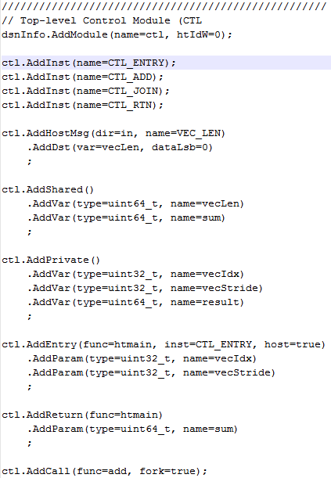
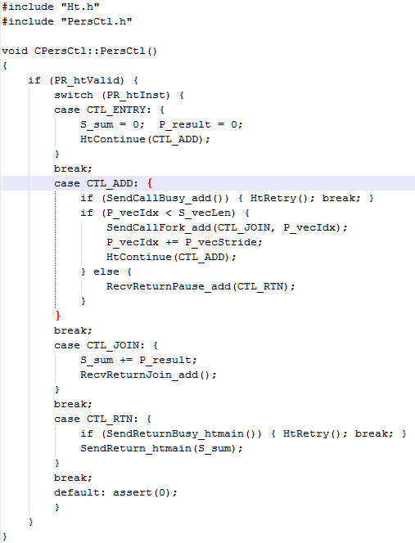
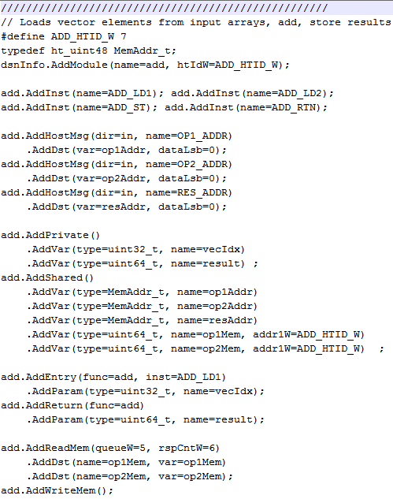
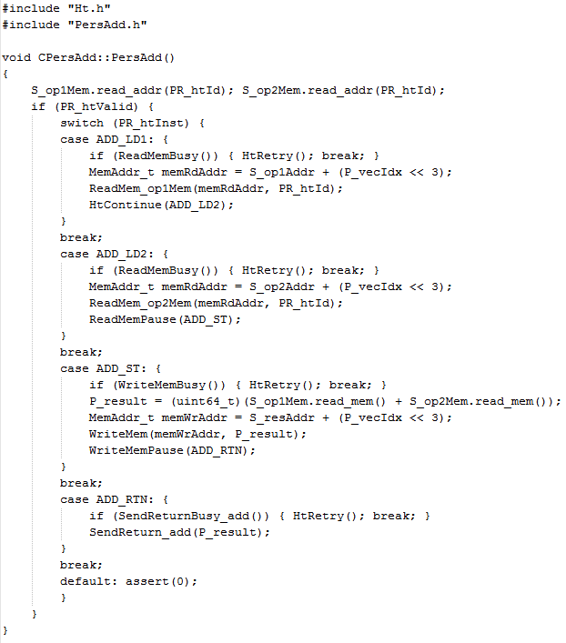
HT Code Example
Personality
HT Example: Vector-add personality
B
A
HT
Vadd Pers.
Add.htd
PersAdd_src.cpp
Ctl.htd
PersCtl_src.cpp
C
Thread control
Control (CTL)
1 thread
Memory Operations
Fn1
128 threads
Call to ADD module
ADD
Fn2
Fn3
Host message
Fn4
Variable declaration
Addition
Module I/O definition
Memory interface
Interface to other modules
HT tool flow
Personality with HT

Slide 22
HT Demo – Spell Checker
Algorithm: Bloom filter
Function: to train a filter, which can report whether an item was seen before or not
Use case: spell checker
Use a dictionary to train a filter
Use the trained filter to check a input word
If it was seen before (i.e. it exists in the dictionary), it is reported as a correct spelling
If not (i.e. it doesn’t exist in the dictionary), it is reported as a wrong spelling

